Slide 1


The Business Case for SQL Server 2019

Slide 2
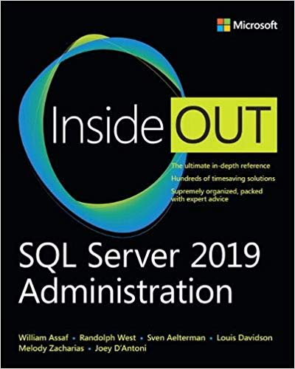
Book Authors: What's your favorite new feature of SQL Server 2019?
Randolph West: Accelerated Database Recovery, as well as UTF-8.
Melody Zacharias: Azure Notebooks! I really love them even if they are not technically a 2019 feature.
William Assaf: Tie between Accelerated Database Recovery (ADR) and scalar UDF inlining. Both are going to really going to help a lot of folks.
Louis Davidson: Scalar function inlining. It is a feature that is small, but it shows that Microsoft has really been listening to us and fixing things that will help programmers produce better code.
Sven Aelterman: Biased: expanded cloud offerings. Unbiased: Python integration.
Meagan Longoria: Accelerated database recovery is cool.
Joey D'Antoni: Scalar Function Inlining.

Slide 3
SQL Server Version Velocity
SQL 2005 RTM- Nov 7 2005
SQL 2008 RTM- Aug 7 2008 – 33 months later
SQL 2008R2 RTM- April 21 2010 – 20 months later
SQL 2012 RTM- March 6 2012 – 23 months later
SQL 2014 RTM- April 1 2014 – 25 months later
SQL 2016 RTM- June 1 2016 – 26 months later
SQL 2017 RTM- Oct 2 2017 – 16 months later
SQL 2019 RTM- Nov 4 2019 – 25 months later

Slide 4
SQL Server Version Velocity
Starting SQL 2017, no more service packs, CU’s only.
Within 12 months, 12 CU’s for SQL 2017.
17 SQL 2017 CU’s in first 24 months
SQL 2019 CU2 released Feb 13, 2020
First public preview of SQL 2019 was only 11 months after SQL 2017 RTM. At that rate we can expect the next public preview of SQL Server 202n in October!

Slide 5
SQL Server is ready to Upgrade
Thanks for compatibility levels inside each database, the only valid reasons to delay a SQL Server upgrade these days are vendor application support.
No technical reasons to buy SQL 2016 over 2017 or 2019.
Price is the same since 2012.
Changes are additive – no code breaking.
Changes to execution plans in SQL 2014 were 95/5.
Easier to upgrade past SQL 2014 from <2014 because of the Query Store introduced in SQL 2016

Slide 6
SQL Version Upgrade Timeline
SQL 2008/2008 R2 are past end of life (July 2019)!
Windows Server 2008/2008R2 end of life Jan 2020.
No longer supported unless you:
Pay lots of money to Microsoft. Srsly.
Migrate your SQL 2008/R2 SQL Server to an Azure VM. Considerably less money.
SQL Server 2012 latest SP End of Support is July 2022
SQL Server 2012 <SP4 no longer supported!
SQL Server 2014 latest SP End of Support is July 2024

Slide 7
Tools to Assist with Upgrades
Database Migration Assistant (DMA) – can perform migration to Azure SQL DB for you
Database Experimentation Assistant (DEA) – AB testing for performance on two platforms using Distributed Replay, including on-prem vs Azure, Windows vs Linux.
Query Tuning Assistant (QTA) – AB testing for performance on two compat levels, same hardware
Will help with the 2014 Cardinality Estimator change
Azure Migrate – Can upload a .csv for an assessment n Azure to be given estimates on compatibility, expected cost for compute and storage. https://azure.microsoft.com/en-us/blog/assess-your-servers-with-a-csv-import-into-azure-migrate/

Slide 8
IT Leadership: Need to Know Changes for SQL 2019
v1.0 of Big Data Clusters
TDE now Standard Edition!
Accelerated Database Recovery (ADR)
Major performance improvements, no code changes
Quality of Life/efficiency improvements
More little things

Slide 9
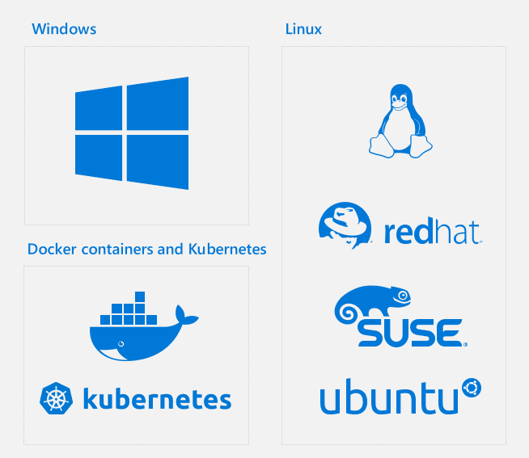
No Longer Just Windows
https://cloudblogs.microsoft.com/sqlserver/2018/09/26/sql-server-2019-celebrating-25-years-of-sql-server-database-engine-and-the-path-forward/

Slide 10
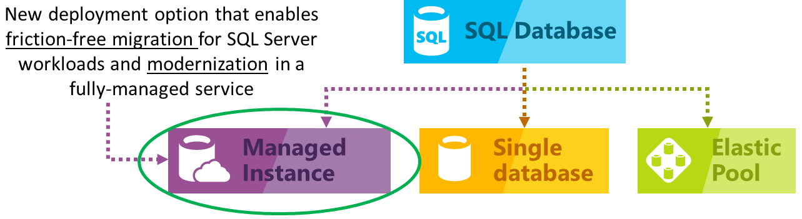
No Longer Just Windows
Coming soon with Azure Arc: Run Azure SQL Database on-prem!
Azure Arc: hybrid cloud+on-prem management for Azure
https://azure.microsoft.com/en-us/blog/migrate-your-databases-to-a-fully-managed-service-with-azure-sql-database-managed-instance/

Slide 11
Unlimited Virtualization Benefit
Azure Dedicated Hosts benefit from Unlimited Virtualization
Not regular Azure VM’s
Provides dedicated physical servers in the Azure DC
Not colo, the dedicated hosts are Azure standard OEM
Bring your on-prem, Enterprise+SA licenses to the host, run unlimited cores of SQL, just like you can on-prem.
Enterprise Edition only, Windows or Linux
https://azure.microsoft.com/en-us/blog/introducing-azure-dedicated-host/
https://www.youtube.com/watch?v=Lmrsg73q-pc&feature=youtu.be

Slide 12
Software Assurance Aids Migration to Azure
For Azure VM’s, use the Azure Hybrid Benefit to apply credits for on-prem licensing with SA for big discounts to SQL on Azure VM’s or Azure PaaS SQL offerings.
You can use your license for both your existing on-prem SQL Server and an Azure SQL platform for up to 180 days while you migrate.
https://azure.microsoft.com/en-us/blog/introducing-azure-dedicated-host/
https://www.youtube.com/watch?v=Lmrsg73q-pc&feature=youtu.be

Slide 13

SQL Server on Linux
Red Hat Enterprise (RHEL) preferred, also Ubuntu, SUSE Linux Enterprise
Support for Active Directory integrated auth
Linux cluster managers like Pacemaker instead of WSFC
Almost fully-featured SQL Server on Linux
New in SQL 2019: Support for replication, MSDTC, CDC

Slide 14
SQL Server on Linux Tooling
Linux tools: SQL Server “mssql-server”
command-line tools Sqlcmd, bcp, drivers and more on Linux
Otherwise, tooling is the same:
Install SSMS on Windows, manage SQL on Linux remotely
Azure Data Studio – lightweight, cross-platform SQL Server management software based Visual Studio Code
Third party software

Slide 15
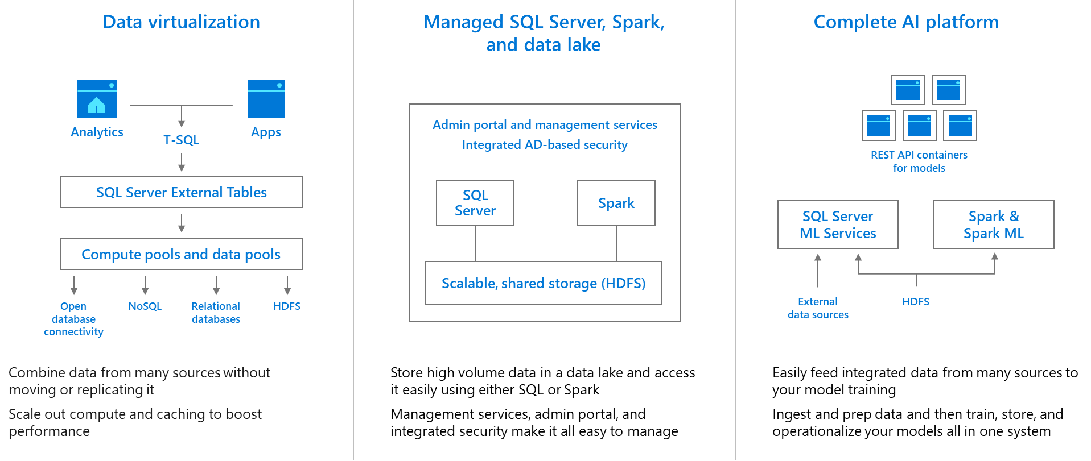
Big Data Clusters: SQL Server, Spark, and HDFS in Kubernetes
The entire data lake within SQL Server 2019
https://cloudblogs.microsoft.com/sqlserver/2018/09/24/sql-server-2019-preview-combines-sql-server-and-apache-spark-to-create-a-unified-data-platform/

Slide 16
Big Data Clusters: SQL Server, Spark, and HDFS in Kubernetes
Big Data Clusters (BDC) is the entire data lake within SQL Server
All data, both relational and non-relational, queryable with TSQL
Minimizes data movement, sprawl of skillsets/languages
Built on Kubernetes, requires some knowledge there to config
No data movement + scale = no ETL, schema/analysis on read

Slide 17
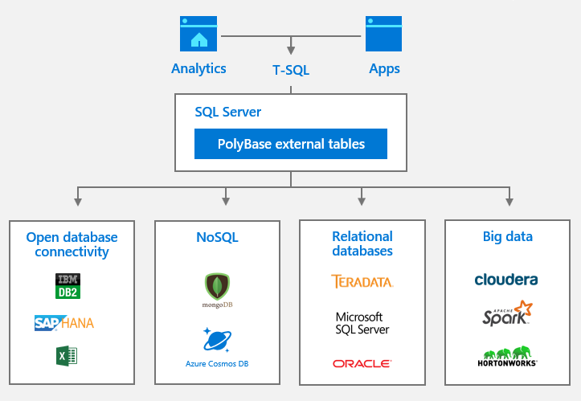
PolyBase Query Service For External Data
Query external, non-Microsoft, non-relational data with PolyBase External Tables aka “Data Virtualization”
That’s right, query Oracle or DB2 with Microsoft T-SQL
https://cloudblogs.microsoft.com/sqlserver/2018/09/25/introducing-microsoft-sql-server-2019-big-data-clusters/

Slide 18
PolyBase Query Service For External Data
Superior alternative to Linked Servers, OPENDATASOURCE, or heterogenous replication:
External tables allows for clear schema
More secure – inside a database, not at instance level
ODBC drivers offer scale-out options
Optimized for large analytic-scale queries
Offers “Push Down” computation for external sources, significantly reducing data transferred
But does require additional setup.

Slide 19
SQL Server Machine Learning Services
2016- “R Services” supported R
2017- Now “Machine Learning Services”, supports R + Python
2019- New features added, including support for external libraries, SQL Server on Linux, clustered service support
You can install R and/or Python depending on requirements.
What’s more, you can install these ML services directly in the Database Engine (in-database as a service called LaunchPad)
or as standalone components without a SQL Server.

Slide 20
Java Runtime Environment
Some features of SQL Server since 2016 have required an installation of the Oracle Java Runtime Environment (JRE).
This is needed for some uses of PolyBase, Apache Spark, or Java extensibility for native Java programming in SQL Server.
In the past, this was the OpenJDK or the Oracle Java SE. Neither option was ideal because of no/poor support.
Starting with SQL 2019, the commercial open source Azul Zulu for Azure Enterprise framework is provided for free, with free Enterprise support. https://cloudblogs.microsoft.com/sqlserver/2019/07/24/free-supported-java-in-sql-server-2019-is-now-available/

Slide 21
SQL Server Feature/Edition changes
Transparent Data Encryption (TDE) is now supported in standard edition in SQL 2019!
This is a big deal!
TDE is “Encrypt Data at Rest” audit solution feature
As well as the Extensible Key Management feature that allows 3rd party (Hardware Security Module) HSM vendors including the Azure Key Vault (AKV)
All hardware caps/limits are the same since SQL 2016

Slide 22
Graph Tables
New in SQL 2017, improving in SQL 2019
Competing with Neo4j or Gremlin (also the CosmosDB Gremlin API)
Graph data is often associated with networks, such as social networks. Graphs data structures consist of nodes and edges.
Nodes are also referred to as vertices, and edges as relationships.
More graph-specific syntax in SQL 2019, support for Merge syntax
For highly interconnected data with many many-to-many relationships (think IMDB)
Hierarchical data can be served with a special hierarchyid data type

Slide 23
Columnstore Indexing
Extremely effective for queries on 10+ million rows
Relatively new (introduced in 2012, limited until 2016)
Not a B+tree; highly compressed columnar data
Available in all editions of SQL Server, not just Enterprise
New in SQL 2019:
Improved internals for memory management
Improved performance of bulk loading to columnstore

Slide 24
Columnstore Indexing
Columnstore indexes aren’t new
Around since SQL 2012, but read-only, and limited use
Read/writeable in SQL 2016
Not a B+tree; highly compressed columnar data on disk and in memory
You can create “nonclustered” or “clustered” Columnstore indexes, though these are in name only.
Can only have one Columnstore index per table.

Slide 25
State of the Columnstore
Starting with SQL 2016, add a Columnstore index to in-memory tables for “real-time analytics” on rapidly-inserted data.
With SQL Server 2016 SP1, Columnstore indexes are available below Enterprise edition (with memory limits)
Starting with SQL 2016, you can now filter the Columnstore index just like a nonclustered index.

Slide 26
Changes for Columnstore
Batch Mode Execution now supported in some rowstore index operations in SQL 2019.
Also new in SQL 2019:
New COLUMNSTORE_ARCHIVE compression level for even more space savings.
Improved internals for memory management.
Improved performance of bulk loading to columnstore.

Slide 27
Azure SSIS Lift-and-Shift with Azure IR
Minimal/no code changes, run SSIS packages in Azure
Part of Data Factory v2
Cloud-based ETL alternative to Boomi, Mulesoft
Azure Integrated Runtime (IR) instead of a SQL instance on-prem or in an Azure VM
https://docs.microsoft.com/en-us/azure/data-factory/tutorial-deploy-ssis-packages-azure

Slide 28
New Installer Smart Default Pages In SQL Setup
TempDB (SQL 2017)
Max Server Memory (SQL 2019)
MAXDOP (SQL 2019)
All intelligently defaulted in the SQL Setup, allowing for smarter “Just Click Next” installs

Slide 29
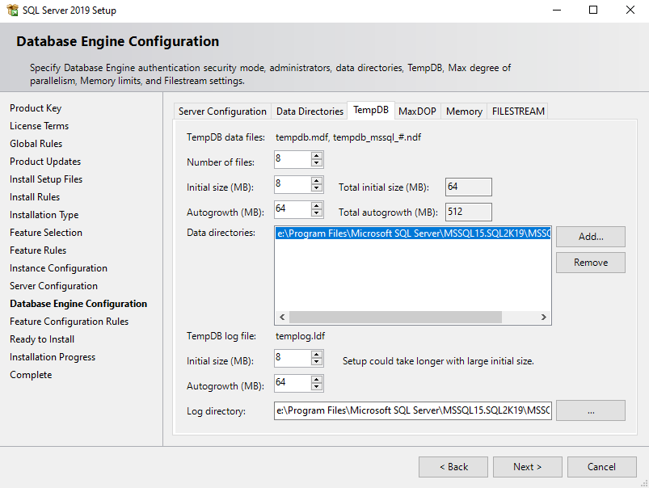
New Installer Smart Defaults - TempDB

Slide 30
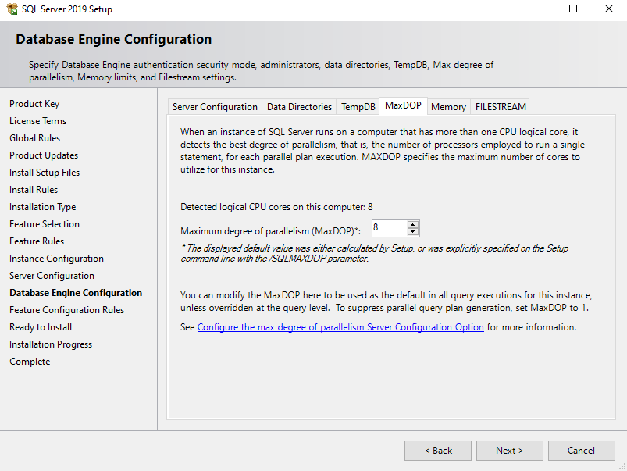
New Installer Smart Defaults - MaxDOP

Slide 31
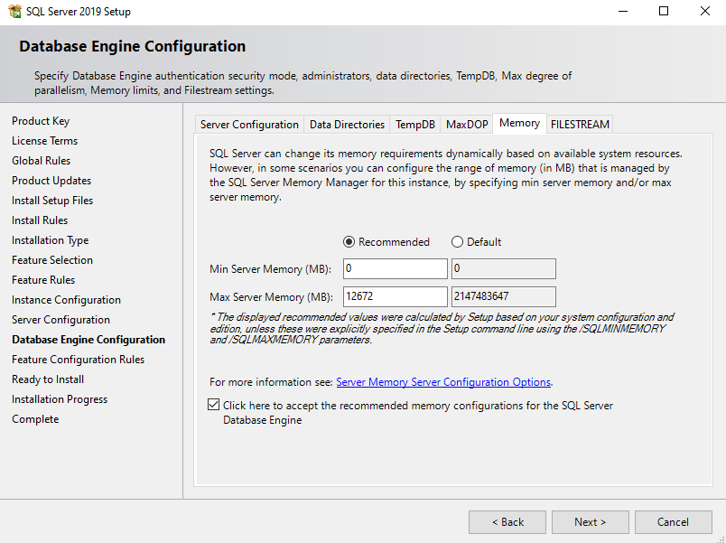
New Installer Smart Defaults - Memory

Slide 32
New in Availability Groups
New: “Automatic read write connection re-routing”
When the connection string connects to a secondary replica with a ReadWrite intent (which is default) it can be redirected to the Primary.
Bypasses the Listener via the new READ_WRITE_ROUTING_URL parameter on the primary.
Connect to any replica, get sent to Primary. Cool!

Slide 33
New in Availability Groups in SQL 2019
Now up to 5 synchronous replicas supported
Availability Groups now supported in Kubernetes
Not supported in SQL for Windows on Docker (yet)

Slide 34
Software Assurance + Availability Groups
Software Assurance – Azure VM SQL licensing for up to 2 secondary replicas in your availability groups are now FREE as of Nov 2019
In case of availability groups, License the cores on the Primary replica, up to three more secondary licenses
1 core of Enterprise Edition with SA covers for free: 1 core of HA replica, 1 core of DR replica, PLUS 1 more DR replica in an Azure VM
DR = readable secondary, HA = failover only
https://cloudblogs.microsoft.com/sqlserver/2019/10/30/new-high-availability-and-disaster-recovery-benefits-for-sql-server/

Slide 35
Hybrid Buffer Pool
SQL Server 2019 can take advantage of Persistent Memory Devices (PMEM) (non-volatile RAM).
Example: Intel Optane DC persistent memory
Can be used by Win Server 2019 with Storage Spaces Direct.
Moves clean buffer pool pages out of RAM and onto PMEM
Dirty pages still stored in DRAM
Can be disabled at the database level, allowing only the most performance critical databases to take advantage.
Both Windows and Linux, Enterprise and Standard edition

Slide 36
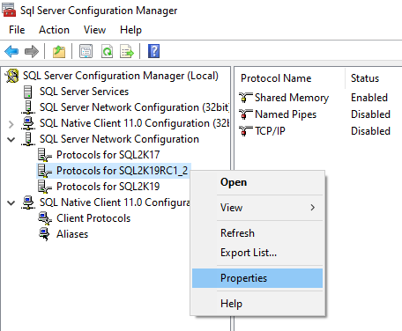
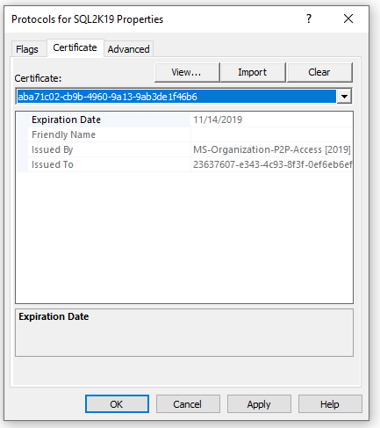
Certificate Management inside Configuration Manager
New in SQL Server 2019: Manage and monitor SSL/TLS certificates
Deploy certs to instances in a AG or FCI easily

Slide 37
UTF-8
Store char/varchar in UTF-8, replacing(?) char/nvarchar.
UTF-8 is the most popular character encoding set for XML, HTML, and the World Wide Web.
90%+ of the web is encoded UTF-8, all languages have most of their characters in a single data page of UTF-8.
Nchar/Nvarchar are UTF-16: better character coverage, 2x the space.

Slide 38
UTF-8
Choosing a UTF-8 collation allows for a wider variety of character values inside the char/varchar data types.
For mostly Latin characters, should be more efficient than UTF-16 (nchar/nvarchar), reducing storage by 50%.

Slide 39
UTF-8
String data is encoded UTF-8 when using a collation with suffix like: LATIN1_GENERAL_100_CI_AS_SC_UTF8
Set at the instance-level or database-level
Unless you need to store characters outside of UTF-8, consider nvarchar no longer useful!
Supported in all editions

Slide 40
Major TempDB improvements
“Memory-optimized tempdb metadata” improves writes to TempDB as internals are rapidly written.
Eliminates lock/latch waits observed in databaseid = 2
Typically a problem in workloads with large numbers of concurrent users and/or excessive TempDB usage
Enterprise only feature for now.
Some minor drawbacks: https://blog.matesic.info/post/Memory-Optimized-TempDB-Metadata

Slide 41
New TSQL Syntax in SQL 2019
OPTIMIZE_FOR_SEQUENTIAL_KEY
Reduces PAGELATCH_EX waits on “hot spots” where rapid inserts occur on the last page
Improves performance up to 30% for concurrent inserts
Add to the definition of each index!
A sequential key was always superior to a random key, now it’s even faster
toolbox\lab - optimize_for_sequential_key testing.sql
https://techcommunity.microsoft.com/t5/SQL-Server/Behind-the-Scenes-on-OPTIMIZE-FOR-SEQUENTIAL-KEY/ba-p/806888
https://support.microsoft.com/en-us/help/4460004/how-to-resolve-last-page-insert-pagelatch-ex-contention-in-sql-server

Slide 42
New TSQL Syntax in SQL 2019
APPROX_COUNT_DISTINCT function
Reduces the amount of reads for mass estimation, in very large table scans.
Could help in determining the bucket sizes for hash indexes
Unless table has millions+ rows, won't be much of a help.
SELECT APPROX_COUNT_DISTINCT(id) from table --vs SELECT COUNT(DISTINCT id) from table

Slide 43
Accelerated Database Recovery
New in SQL Server 2019
Instant rollback of long-running transactions or maintenance operations like index rebuilds
Instant recovery for databases at startup, no more delay after server restart
Can truncate the transaction log around long running transactions, reducing log file size.

Slide 44
Accelerated Database Recovery
Works via a persistent Version Store stored directly in the User database, may increase .mdf size by 10%+.
As a result it is NOT enabled by default
ALTER DATABASE whatever SET ACCELERATED_DATABASE_RECOVERY = ON;
Otherwise, it is downright magical.
Supported in Enterprise AND Standard edition.
Works in ANY compatibility level in SQL 2019!

Slide 45
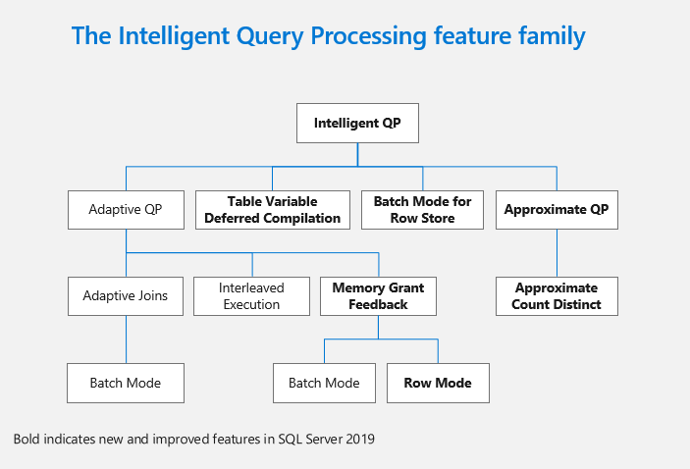
New Intelligent Query Processing features
https://cloudblogs.microsoft.com/sqlserver/2018/09/26/sql-server-2019-celebrating-25-years-of-sql-server-database-engine-and-the-path-forward/

Slide 46
Performance Boost: Batch mode on rowstore
Batch mode operators work more efficiently for large rowcounts, a major scalability improvement
On by default in compat 150 (SQL 2019)
Prior to compat 150, only possible on columnstores. With compat 150, batch mode is another tool for the query optimizer for use on heaps and B-tree indexes.
New BATCH_MODE_ON_ROWSTORE database scoped configuration https://docs.microsoft.com/en-us/sql/relational-databases/performance/intelligent-query-processing?view=sql-server-ver15#batch-mode-on-rowstore
Notes:
Batch mode versions of Execution Plan operators like bitmap filters, hash joins, hash-based aggregates, sorts, window aggregates, filters, concatenation, compute scalars.

Slide 47
Performance Boost: Memory Grant Feedback
Already had Memory Grant Feedback for batch mode.
Now supported for row mode.
More efficient memory estimation and handling
Prevents spill to disk if memory initially underestimated
Enterprise edition feature only in SQL 2019 for both row and batch mode.
On by default in compat 150 (SQL 2019)

Slide 48
Performance Boost: Scalar UDF inlining
Developers now off the hook for some bad habits!
Will immediately, dramatically improve performance where Scalar UDF’s are abused, no code changes.
“Scalar UDF Inlining” automatically transforms inline-able UDFs into relational expressions.
Prevents UDF's in the SELECT or ON part of queries from exploding query cost with RBAR.

Slide 49
Performance Boost: Scalar UDF inlining
On by default with Compatibility Level 150 (SQL 2019), in all editions.
This can be disabled – there were “several” issues resolved in CU2, one still reported with nested UDF’s.
https://support.microsoft.com/en-us/help/4538581/fix-scalar-udf-inlining-issues-in-sql-server-2019
https://twitter.com/tarynpivots/status/1228334842300882944
Another feature introduced in SQL 2017, Interleaved Execution can help with TVF’s.

Slide 50
Performance Boost: Table variable deferred compilation
Improves plan quality, performance of table variables
Biggest difference from Temp Tables: Table variables still lack column statistics.
On by default with compat level 150.
https://blogs.msdn.microsoft.com/sqlserverstorageengine/2018/07/16/public-preview-of-table-variable-deferred-compilation-in-azure-sql-database/

Slide 51
Performance Boost: Table variable deferred compilation
Existing behavior: Table variables are compiled along with all other statements, cannot know the actual row count at time of execution, so a fixed guess of one row is used.
This is why table variables are only good for very small rowcounts
Underestimation of rowcount caused poor performance
In SQL 2019: compilation behavior matches that of temp tables, and results in the actual rowcount being used in the plan, much better plans. No change if you’re already using Table vars appropriately (for very small rowcounts only).

Slide 52
More Specific string truncation error messages
Introduced in SQL 2019. With SQL 2017 CU12 and SQL 2016 SP2 CU6 this can be enabled with trace flag 460 (recommended!)
Old:
Msg 2628, Level 16, State 1, Line 10
String or binary data would be truncated.
The statement has been terminated.
New: Msg 2628, Level 16, State 1, Line 37
String or binary data would be truncated in table 'tempdb.dbo.string_truncation_test', column 'chars'.
Truncated value: 'aaaaaaaaaaaaaaaaaaaaaaaaaaaaaaaaaaaaaaaaaaaaaaaaaaaaaaaaaaaaaaaaaaaaaaaaaaaaaaaaaaaa aaaaaaaaaaaaaaaa'.
The statement has been terminated.
Lab - toolbox\lab - string truncation error message improvement in SQL 2019.sql
https://support.microsoft.com/en-us/help/4468101/optional-replacement-for-string-or-binary-data-would-be-truncated

Slide 53
New Data Classification Schema
Before SQL 2019, Data Classification feature used database extended properties to store this data.
Now, a dedicated schema for this data in SQL 2019.
Designed to aid auditing, GDPR or CCPA compliance.
Related to the “SQL Data Discovery and Classification” tool introduced in SSMS 17.5. https://docs.microsoft.com/en-us/sql/relational-databases/security/sql-data-discovery-and-classification?view=sql-server-ver15&tabs=t-sql
Available in all editions.
Notes:
california consumer privacy act

Slide 54
SQL Assessment API
New programmatic interface for Microsoft-provided SQL Server Health Checks.
Can access with .NET, PowerShell, etc.
Part of the new SMO, actually delivered with the latest editions of SSMS, not SQL Server.
Available in all editions.
https://docs.microsoft.com/en-us/sql/sql-assessment-api/sql-assessment-api-overview?view=sql-server-ver15

Slide 55



HEALTH CHECK
REMEDIATION
MANAGED SQL
The Sparkhound SQL DBA Team
Knowledge Transfer – We work with your Devs, DBA’s, “accidental” DBA’s.
Pros Nearby – Sparkhound’s DBA team of FTE’s are US-based, CT zone.
Microsoft & Peer Recognized – Sparkhound DBA team is 100% Microsoft certified, and members have spoken at conferences and user groups.
Proven Success – For years we have supported servers in US and Europe.
Dev Background – Experience as former developers provides context.
The Checklist - Reference for future checks, audit prep, new SQL builds.

Slide 56
Sparkhound Managed SQL
HEALTH CHECK
REMEDIATION
MANAGED SQL
Interactive Health Check
Windows, SQL, Process
Remediation
Planning
Proactive Health Checks
Reactive Alerting
Regular Maintenance Windows
Knowledge Transfer
Special Project Assistance
Documentation/Process Improvement
Trending/Analysis
Checklist
Critical
High
Medium
Low
Checklist
Maintenance
Window
Managed Services
Emphasis on Knowledge Transfer
What, Why, How

Slide 57
Sparkhound SQL DBA Consulting Services
Performance Tuning, with App Services team
Reporting, with our Data Analytics team
Upgrades/Migrations/Data Conversions
High Availability/Disaster Recovery solutions
Pre-audit, encryption, database security
Maintenance/administration
Automation/PowerShell
Azure SQL (IaaS or PaaS) architecture
Training/Knowledge Transfer/skillset updates

Slide 58

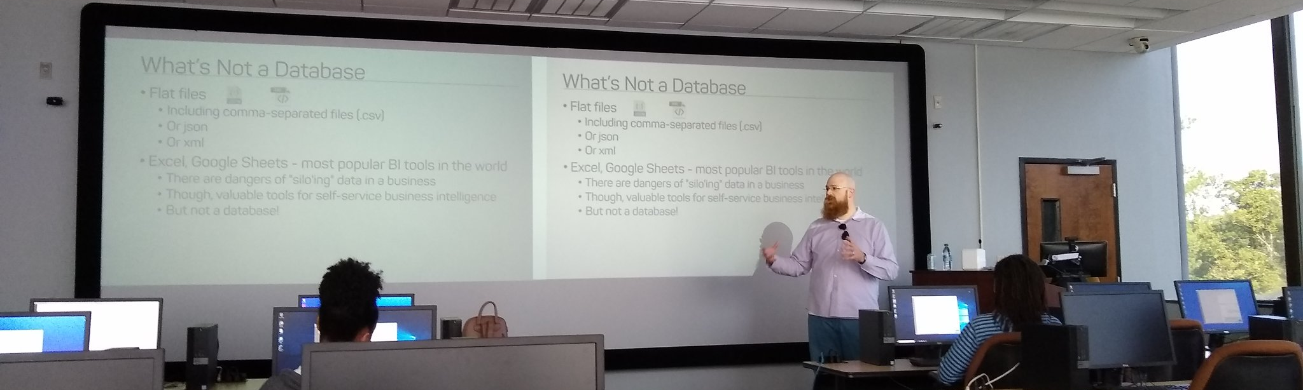
Support your Local STEM Initiatives
I encourage you to find, then donate time and money to local STEM education initiatives where you live. Get involved!
There is almost certainly some nonprofit where you live that needs your enthusiasm and skills to close the achievement gap.
https://www.thewallsproject.org/programs/futures_fund/

Slide 59
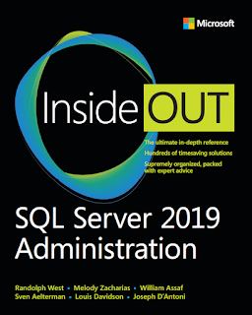
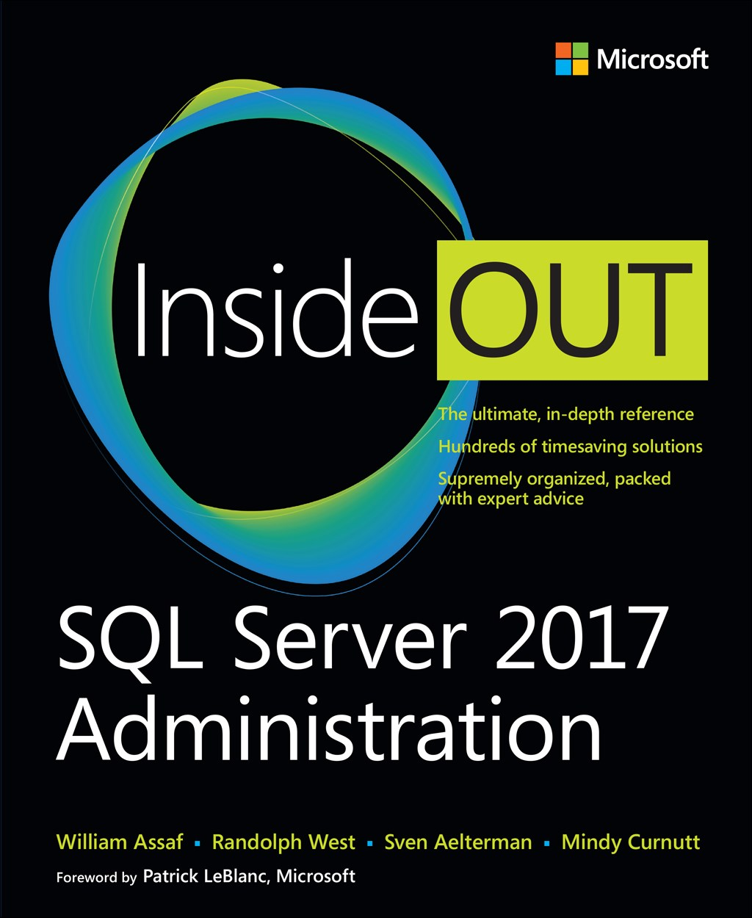
SQL Server 2017 Inside Out
SQL Server 2019 Administration Inside Out
by Microsoft Press
2017 published Feb 2018
2019 published March 2020

Slide 60

Bio and contact
William D Assaf, MCSE
Baton Rouge SQL Server UG board
Principal Consultant, SQL at Sparkhound
William.Assaf@sparkhound.com
@william_a_dba
This presentation, including all source code, available at my blog:
SQLTact.com

